Slide 1
Forces in 2-D
Normal Force and Friction Force

Slide 2
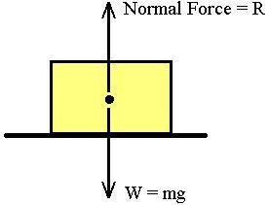
Normal Force
Normal Force is always perpendicular to the surface that an object is on.

Slide 3
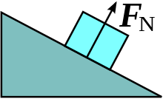
If the surface is not parallel with the ground then F_{N} is not perpendicular with the ground

Slide 4
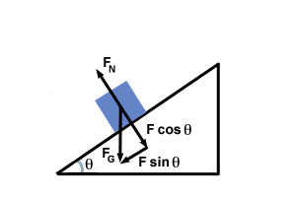
To resolve the force we must use trigonometry

Slide 5
Once resolved we only use the forces that are perpendicular to each
other in solving problems

Slide 6
F_{g} is no longer useful as we now know its vector components (F_{gx} and F_{gy})
can ignore now

Slide 7
Resolving other Forces
If this box is moving with uniform motion then F_{net}=0
so,
F_{N}+F_{y} = F_{g}
and
F_{f} = F_{x}
F
F_{N}
F_{y}
F_{x}
F_{g}
F_{f}

Slide 8
Example
A 30.0kg crate experiences an applied force of 100N acting at an angle of 30^{O} above the horizontal. What is the normal force F_{N} on the block?
What is the horizontal acceleration?

Slide 9
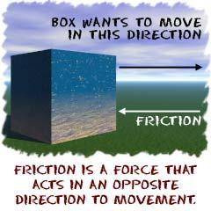
Friction
A force that oppose two objects sliding against one another.
Two types
a) kinetic friction
b) static friction

Slide 10
Kinetic Friction (f_{k})
The frictional force that occurs between two objects sliding against each other.
3 basic rules
1. f_{k} is independent of velocity
2. f_{k} is independent of contact surface area
3. f_{k} is directly proportional to F_{N} and how ‘rough’ the surfaces are

Slide 11

To find kinetic friction (f_{k})
f_{k} = _{k} F_{N}
coefficient of friction

Slide 12
The coefficient of friction
_{k} is the coefficient of friction, the larger the value the ‘rougher’ or stickier’ the surfaces are.
_{k}= 0 is a frictionless surface
_{k} = 1 means that you would use the same energy to slide a body as to pick it up

Slide 13
Example 1
A 20 kg sled slides over a horizontal icy surface against a frictional force of 16N. Find the Coefficient of kinetic friction between the sled and the ice.

Slide 14
Example 2
A force F of 65N[right] acts at an angle of 35^{O} above the horizontal upon a block with a weight of 100N moving at a constant velocity to the right. Draw a Free Body Diagram and resolve all forces.

Slide 15
Example 2 continued
Determine the force of friction between the block and the surface its sliding on
Determine the normal force
Determine the coefficient of friction

Slide 16

Static Friction f_{s}
Static friction exists when the contact surfaces do not slide relative to one another.
_{s} > _{k}, there is less friction when objects are moving

Slide 17

f_{s} can change
If the man pushing the box exerts 100N of force and the box does not move what is fs?
If the man pushing the box exerts 200N and the box continues to remain stationary what is the new fs?
If at 350N of force applied by the man, the box just begins to accelerate we call this f_{max}, the maximum amount of static friction
F applied
f_{s}

Slide 18
coefficient of friction
Magnitude of static friction changes according to the magnitude of the applied force, so to find
_{s} we must use f_{max}, the maximum force that can be applied to a body to just begin its movement.

Slide 19
Example
A man is pushing a couch and it just begins to move when a force of 150N is applied to it.
What is the f_{max} between the couch and floor?
What is the coefficient of friction if the couch weighs 100kg?

Slide 20
Example 2
A student pushes a calculator along a table with a horizontal force of 1N, but the calculator remains motionless.
What is f_{s} on the calculator?
Can the static force of friction ever be smaller than 1N?

Slide 21
Example 3
A woman pulls on a 30kg box with a rope at an angle at 25^{O}. She initially pulls with a force of 90N without moving the box What is f_{s}?
30kg

